Slide 1

TECHNICAL TRAINING MODULE FOR
GALLEY / STEWARD DEPARTMENT

Slide 2
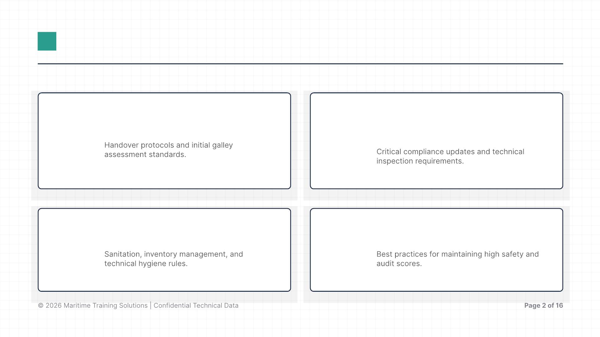
AGENDA & OBJECTIVES
Ship's Takeover
RightShip Inspection (RSI) &
RISQ 3.2
I
II
III
Galley Readiness
IV
Key to Success

Slide 3

SECTION I
Ship's Takeover

Slide 4
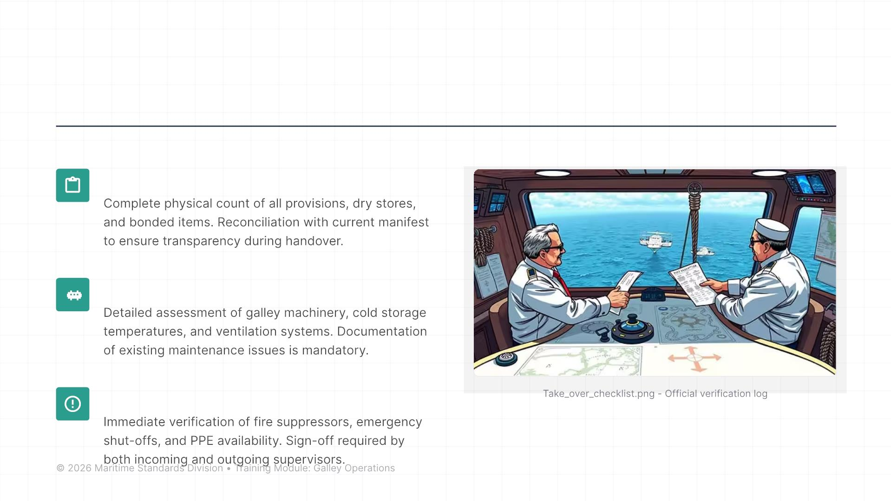
TAKEOVER PROCEDURES AND
DOCUMENTATION
Inventory Verification
Condition Reporting
Safety Equipment

Slide 5
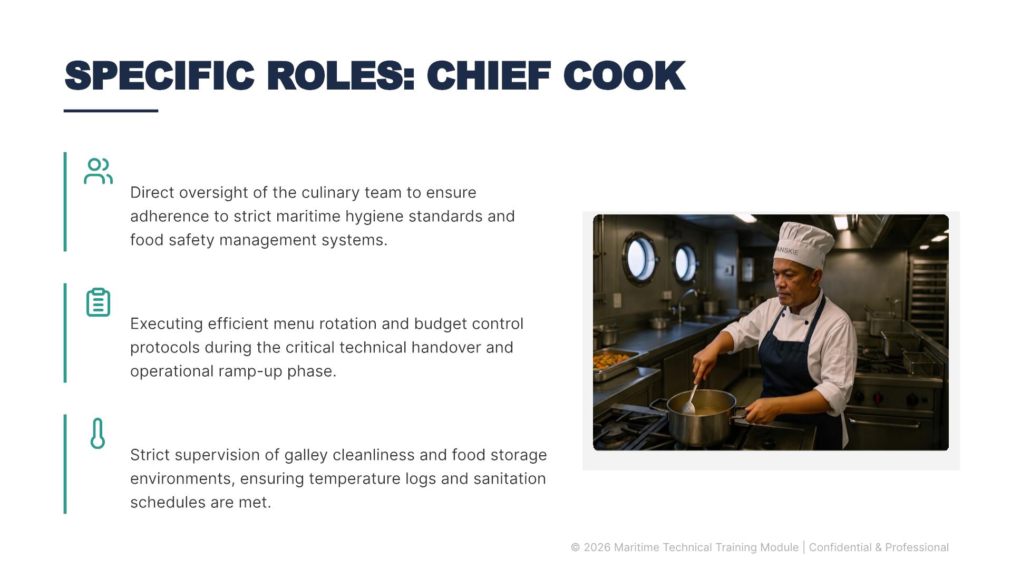
SPECIFIC ROLES: CHIEF COOK
Leadership & Food Safety
Menu Planning & Budget
Storage Sanitation Control

Slide 6
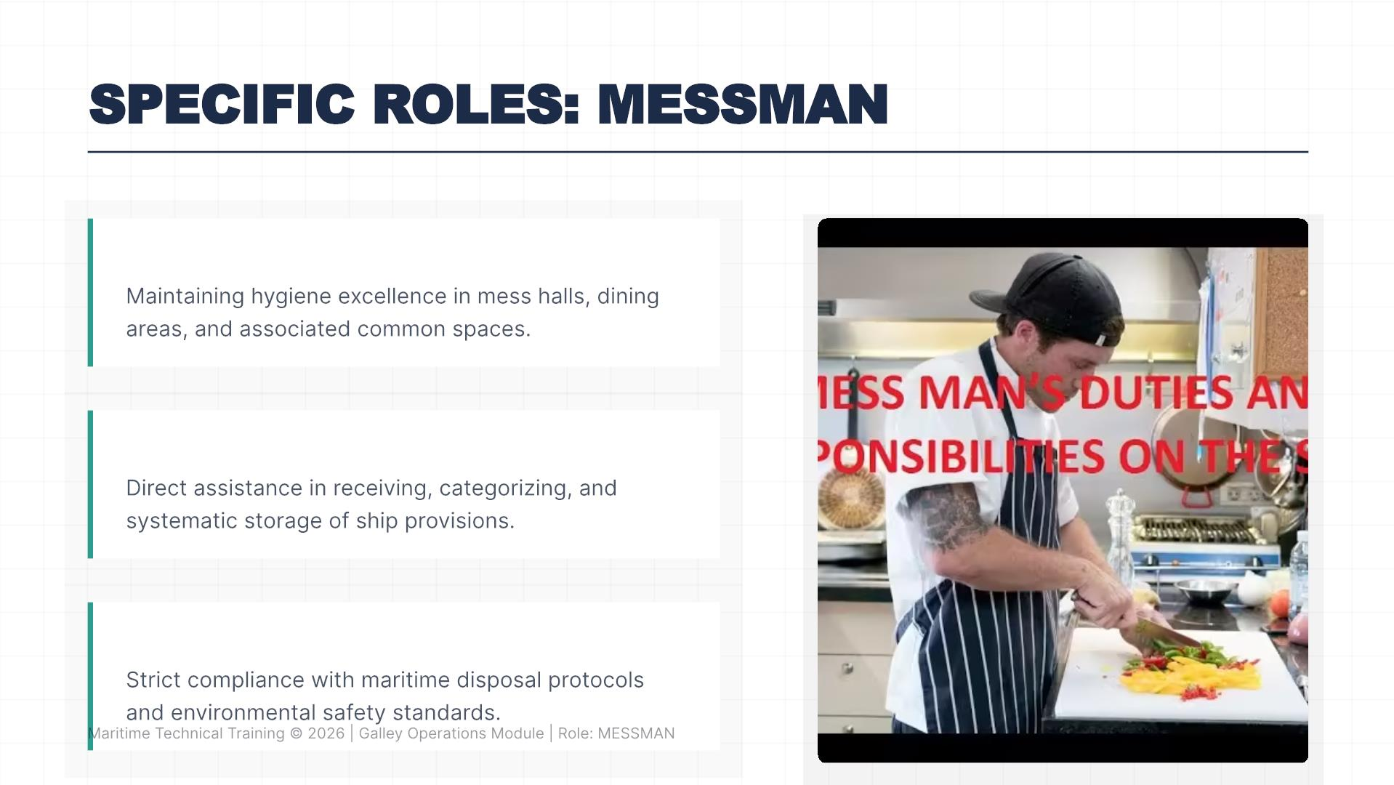
SPECIFIC ROLES: MESSMAN
Sanitation
Provisioning
Waste Management

Slide 7

SECTION II
RightShip Inspection (RSI)

Slide 8
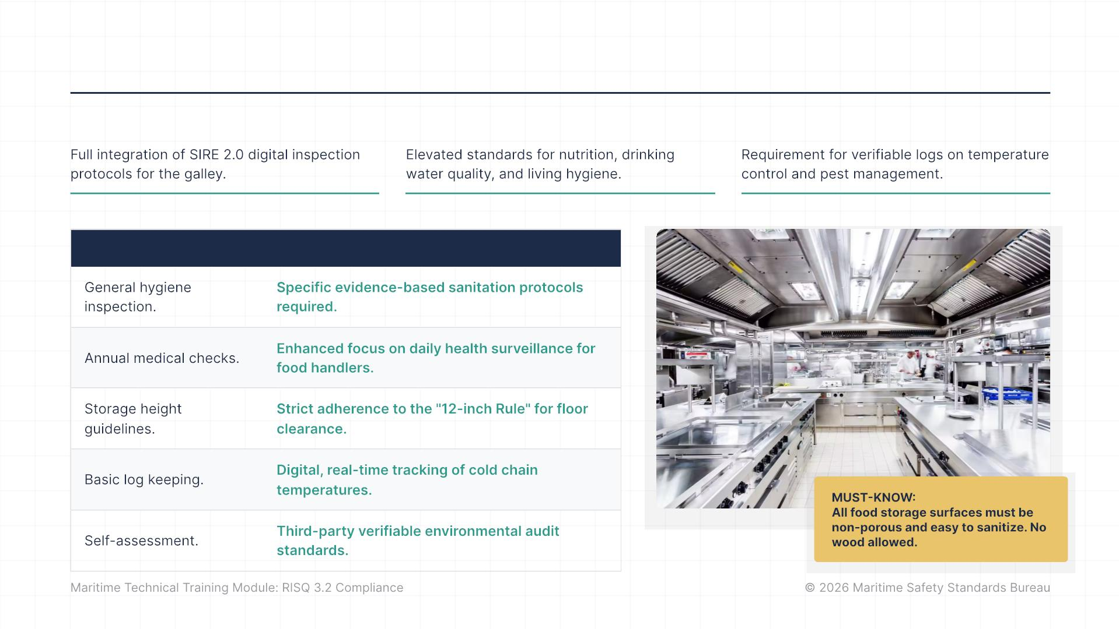
RISQ 3.2 UPDATE: WHAT'S NEW?
Latest Updates
Crew Welfare
Documentation
Previous Version
RISQ 3.2 Changes

Slide 9
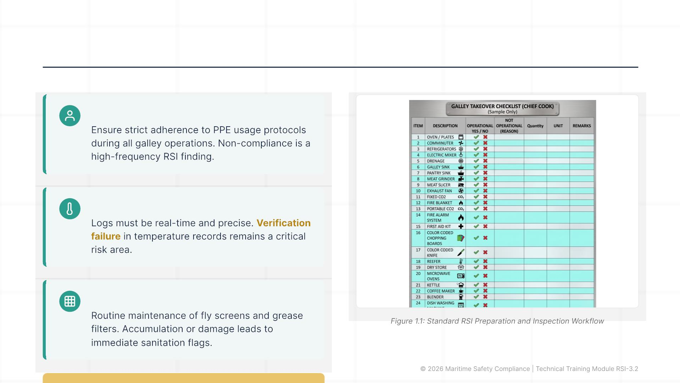
RSI CHECKLIST: COMMON FINDINGS
Personal Protective Equipment (PPE)
Temperature Logging Accuracy
Screens & Grease Filters

Slide 10

SECTION III
Galley Readiness

Slide 11
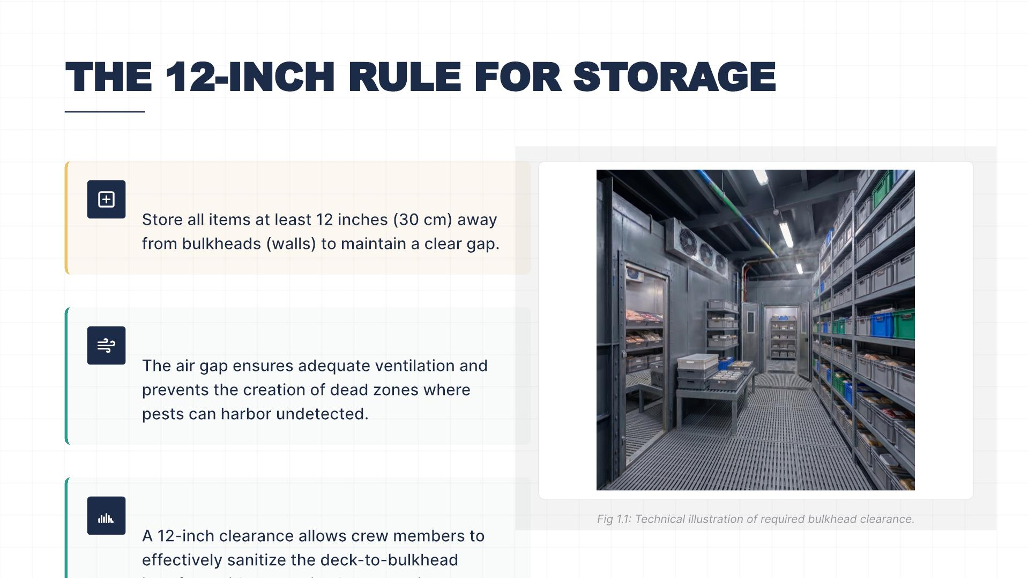
THE 12-INCH RULE FOR STORAGE
Technical Mandate
Ventilation & Pest Control
Cleaning Accessibility

Slide 12
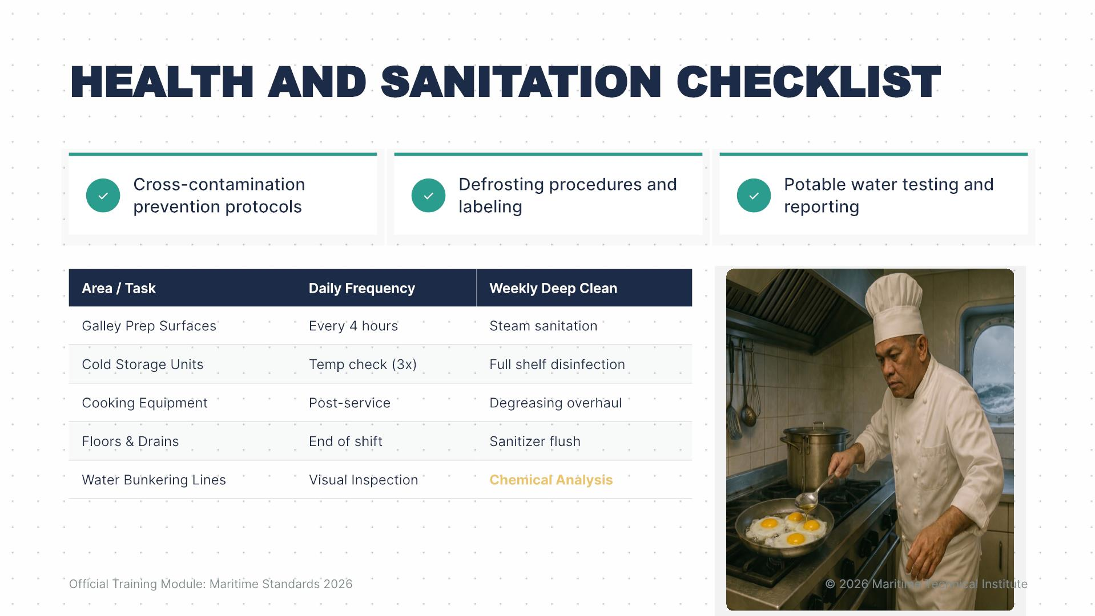
HEALTH AND SANITATION CHECKLIST

Slide 13

KEY TO SUCCESS

Slide 14
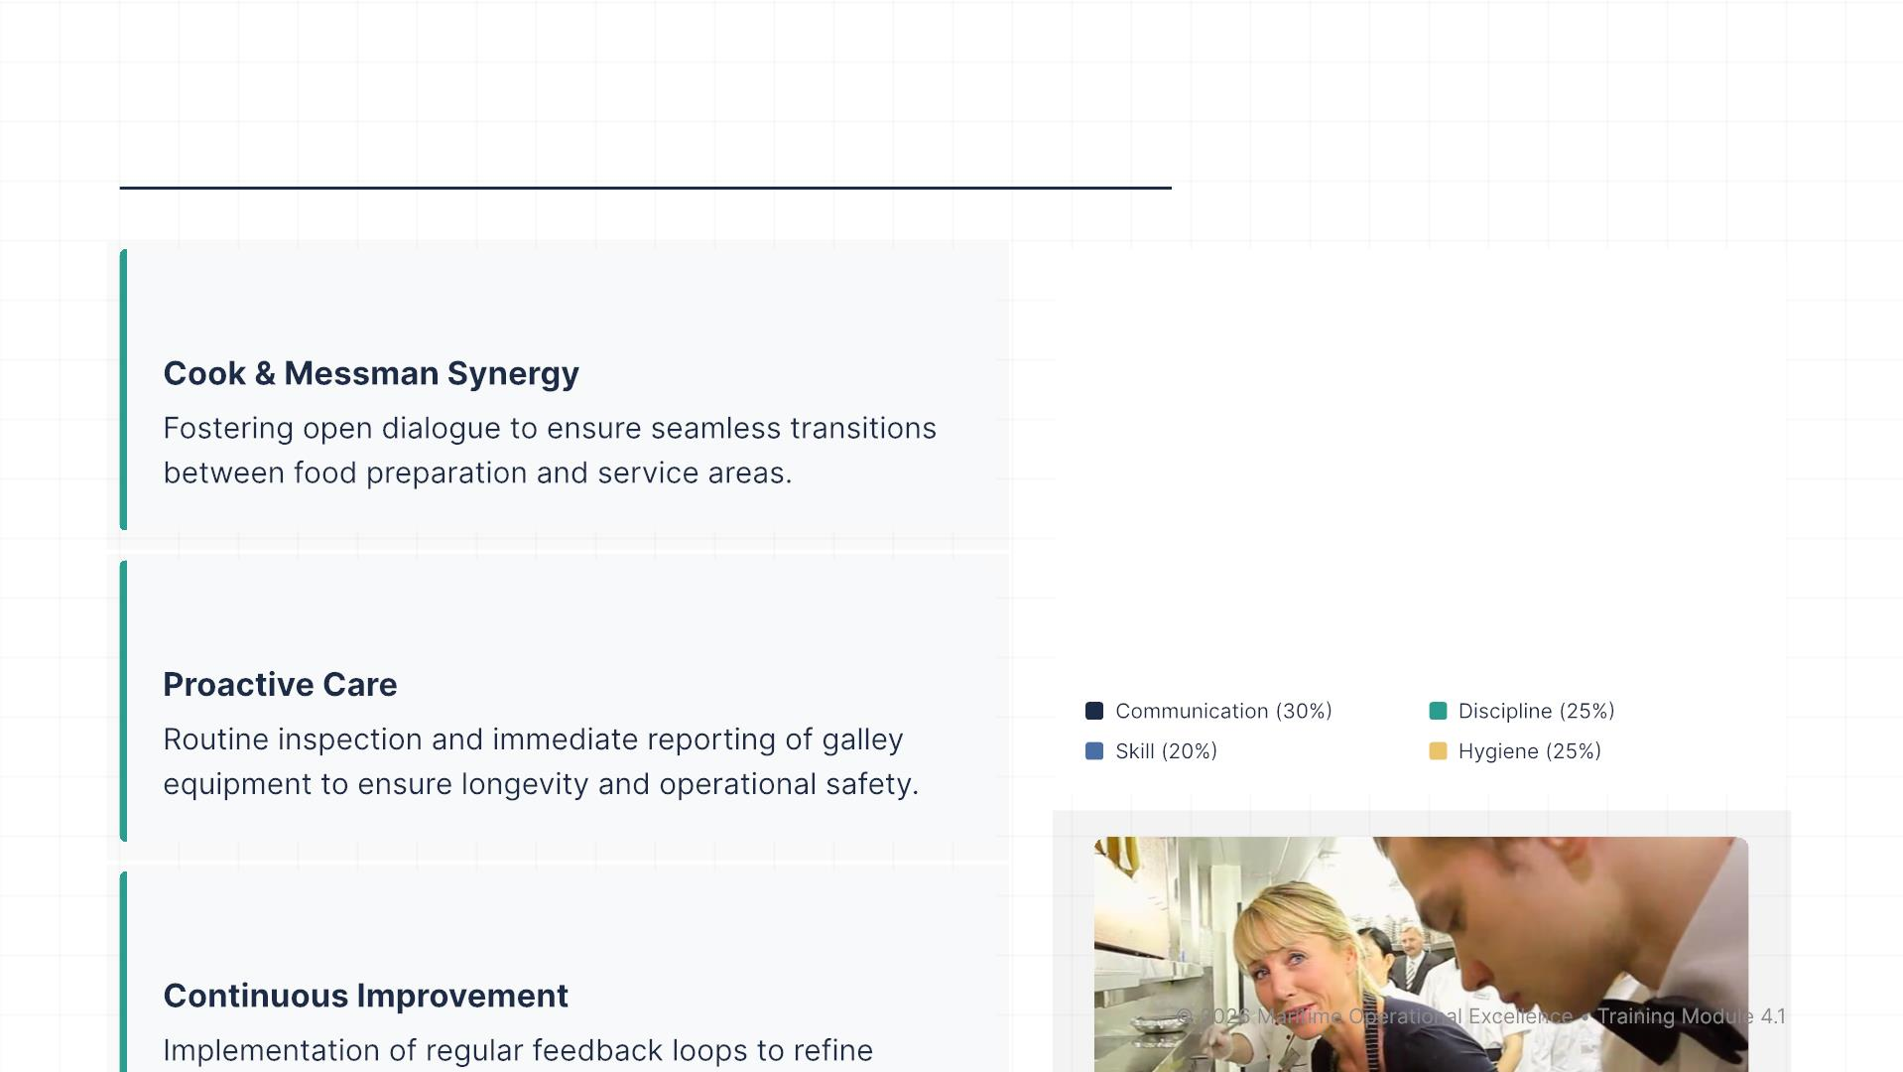
Essential Traits for Galley Staff
COMMUNICATION
TEAM SUCCESS COMPONENTS
MAINTENANCE
DEVELOPMENT

Slide 15
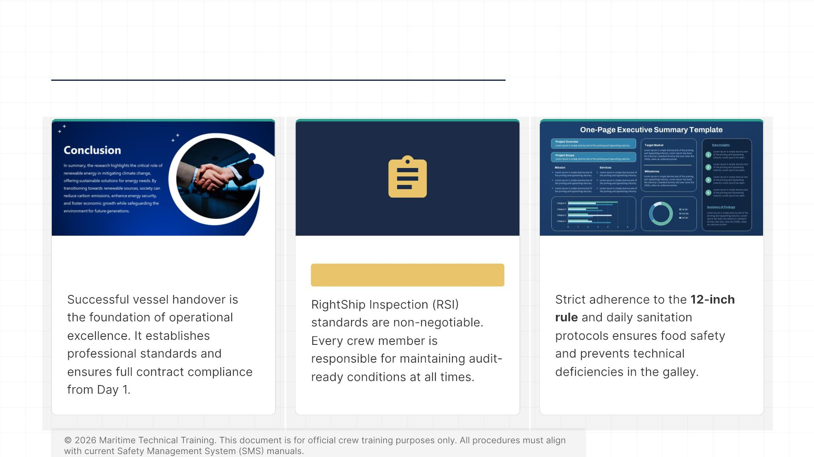
SUMMARY & KEY TAKEAWAYS
Initial Takeover
RSI Compliance
Daily Standards
THANK YOU

Slide 16
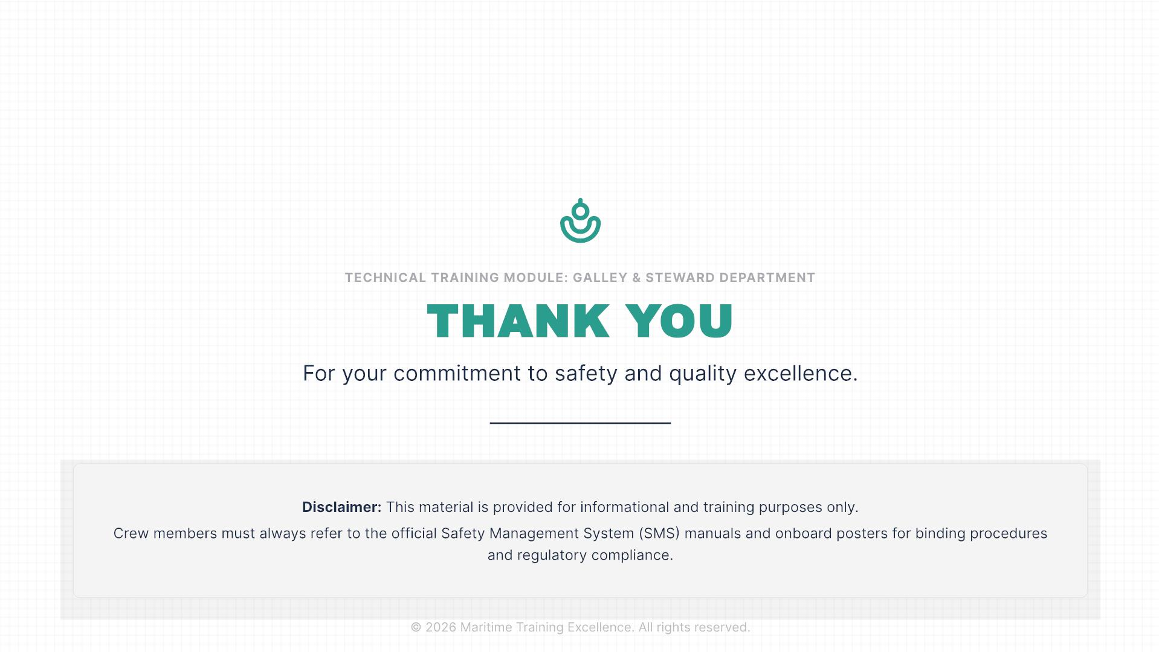
THANK YOU

